Slide 1
Lead Scoring Case Study
Chakri Sai VC.K
Chirag Panchal
Chitty Tangirala

Slide 2
Problem Statement
X Education, an online course provider for industry professionals, is facing a low lead conversion rate of around 30%. Despite acquiring many leads through website visits and marketing campaigns, only a small percentage of them convert into paying customers. The company wants to improve its efficiency by identifying the most promising leads 'Hot Leads' so that the sales team can focus on them, ultimately increasing the lead conversion rate to approximately 80%.

Slide 3
Assumptions
Dropped few columns that were generated when calling the data dictionary.
Performed a Duplicate Check.
Also dropped unwanted columns.
Removed null values.
Cleaned the data to prepare for analysis & model creation.

Slide 4
Approach
Imported pandas library to load and manipulate the dataset.
Imported the NumPy library to assist in handling null and duplicate values.
Dropped columns that were not useful for further analysis.
Used the mean() function to identify columns with more than 60% NA values and removed them.
Performed a detailed analysis of the data.
Used Countplot, Subplot, Violinplot.
Converted binary values Yes/No to 1/0.
Preparing data for further processing.

Slide 5
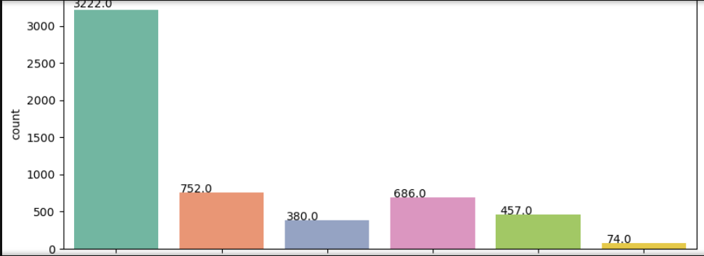
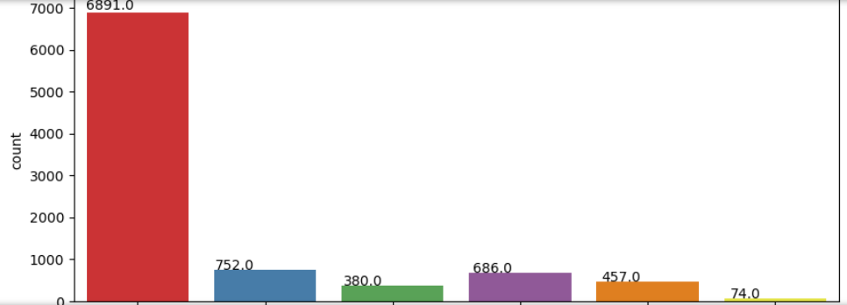
Exploratory Data Analysis

Slide 6
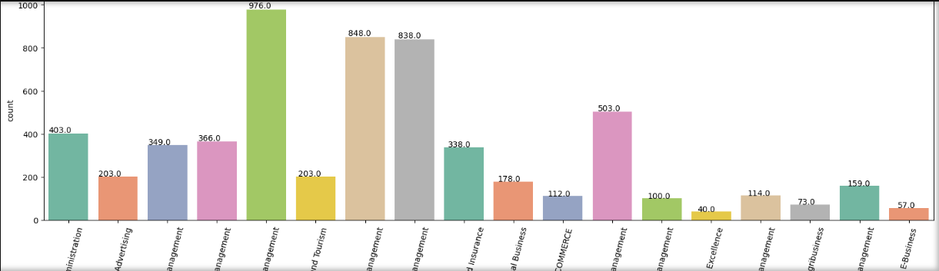
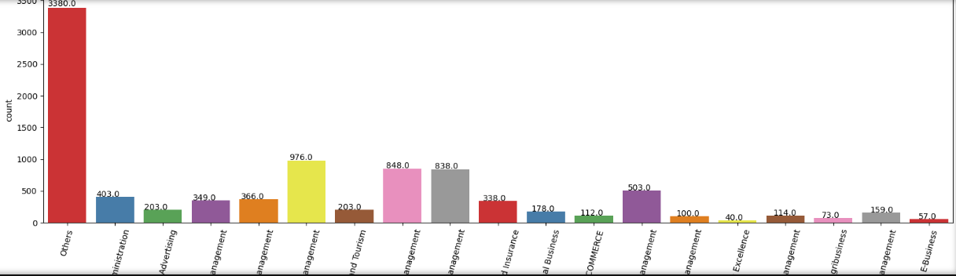
Exploratory Data Analysis

Slide 7
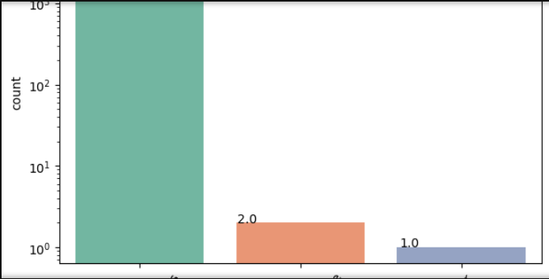
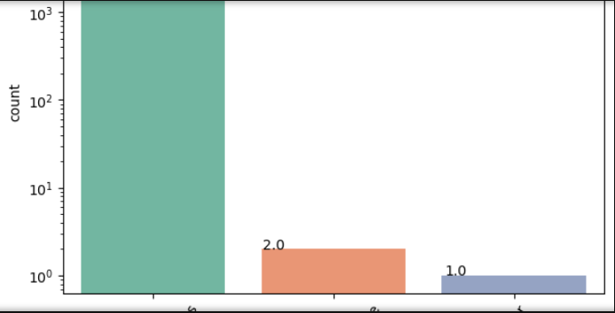
Exploratory Data Analysis

Slide 8
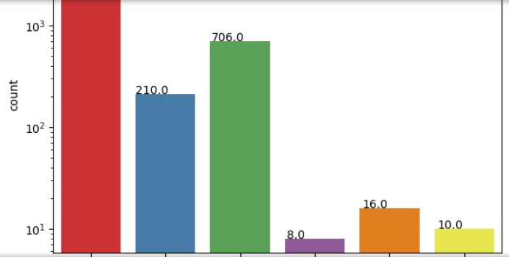
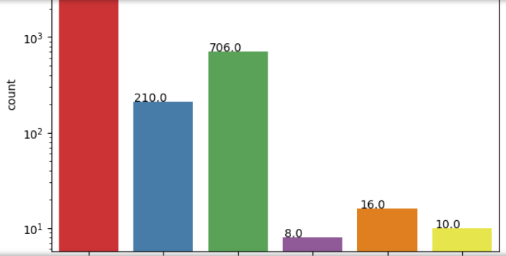
Exploratory Data Analysis

Slide 9
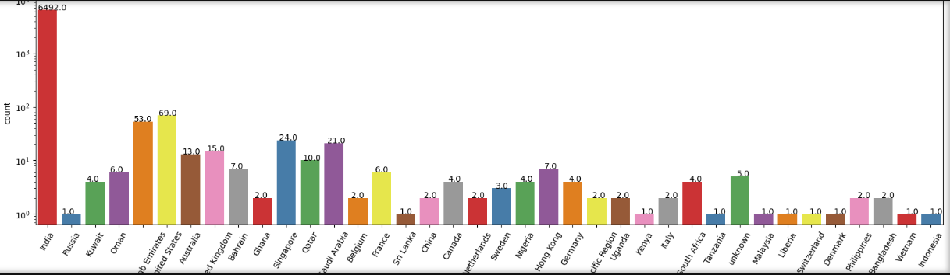
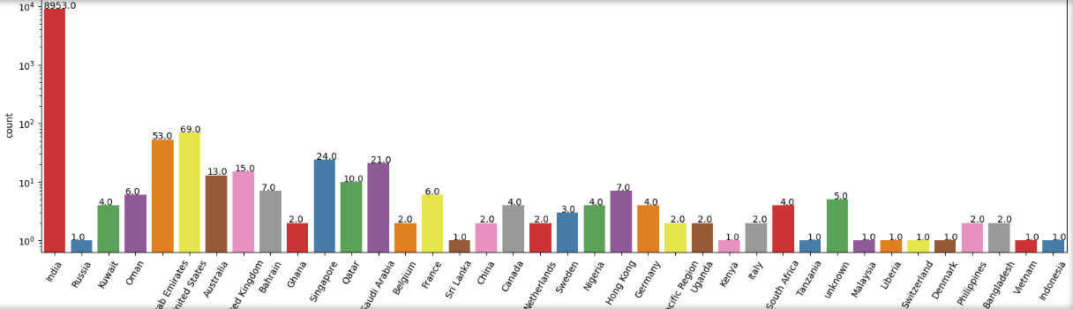
Exploratory Data Analysis

Slide 10
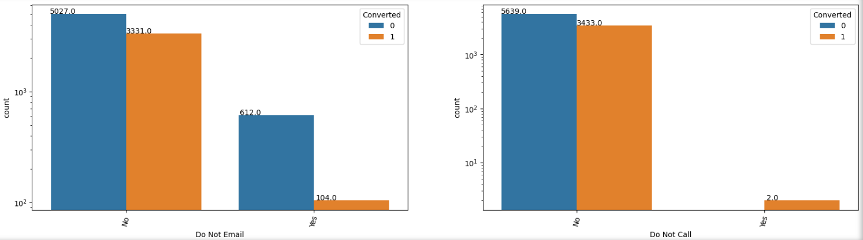
Exploratory Data Analysis

Slide 11
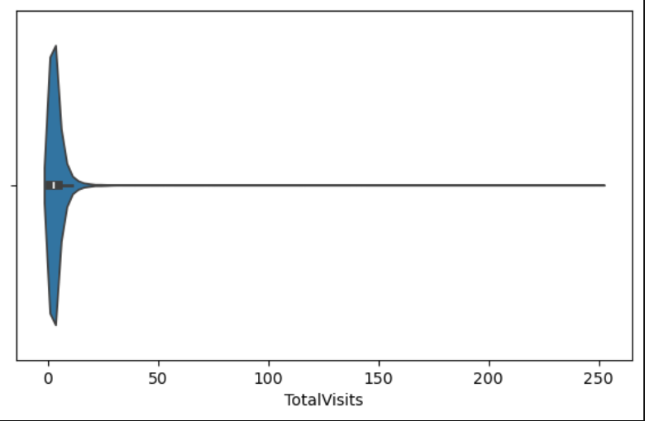
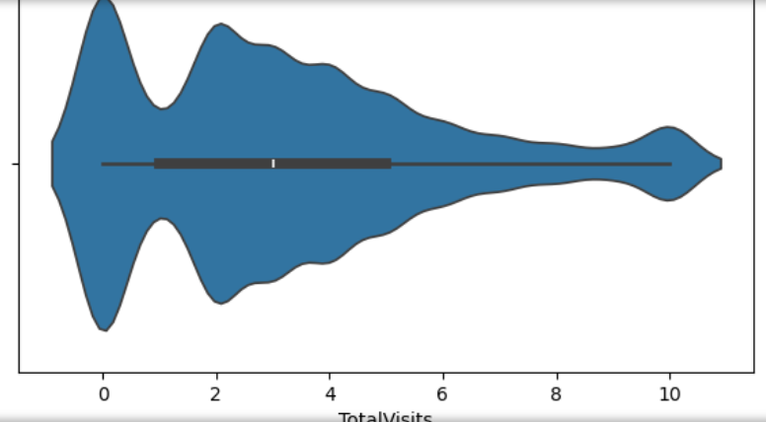
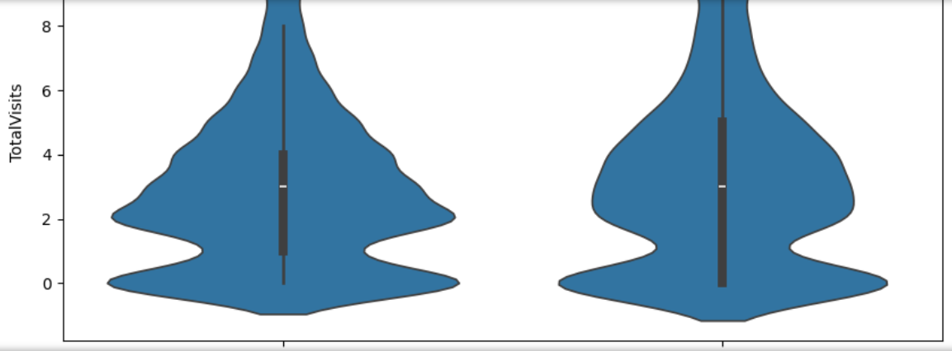
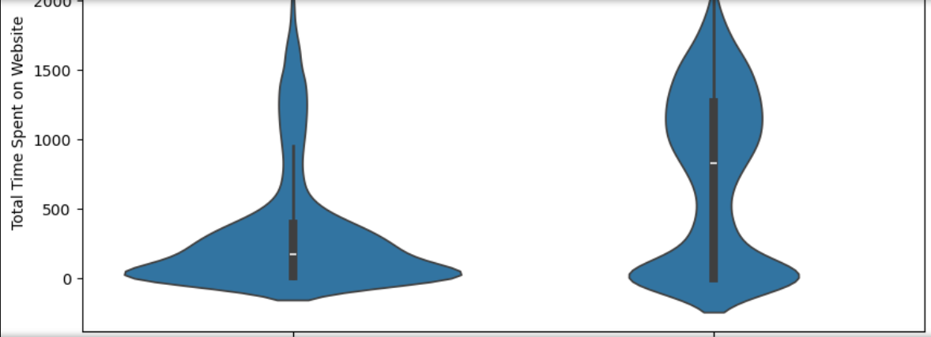
Exploratory Data Analysis

Slide 12
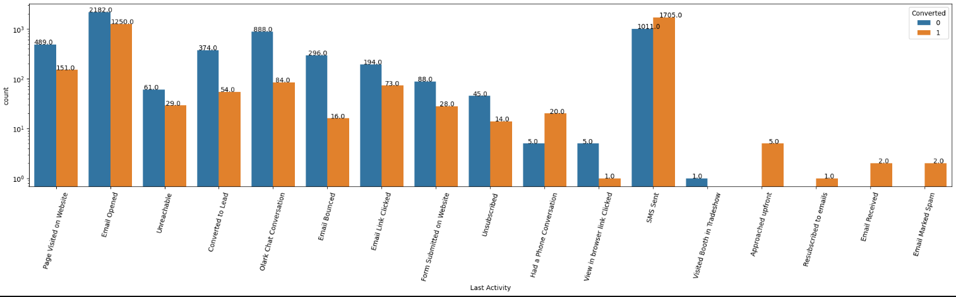
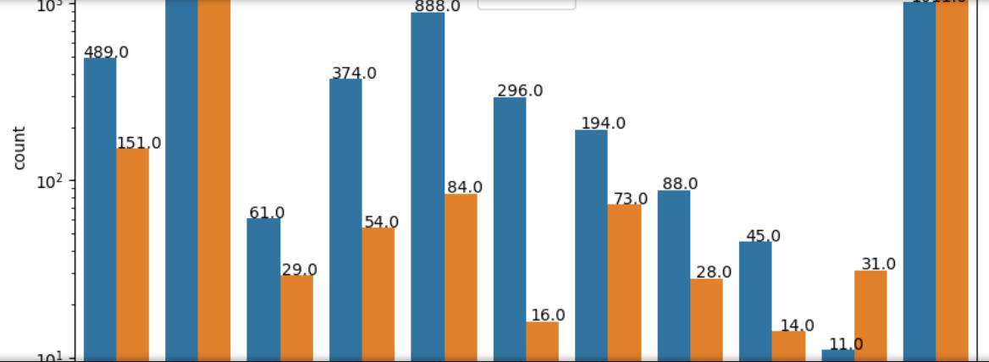
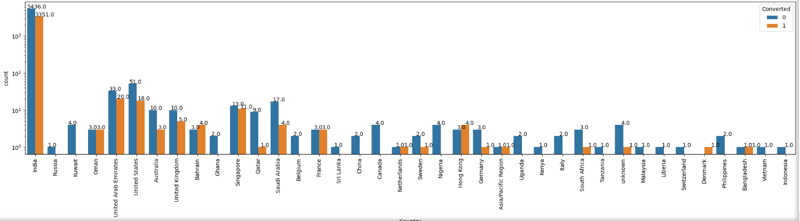
Exploratory Data Analysis

Slide 13
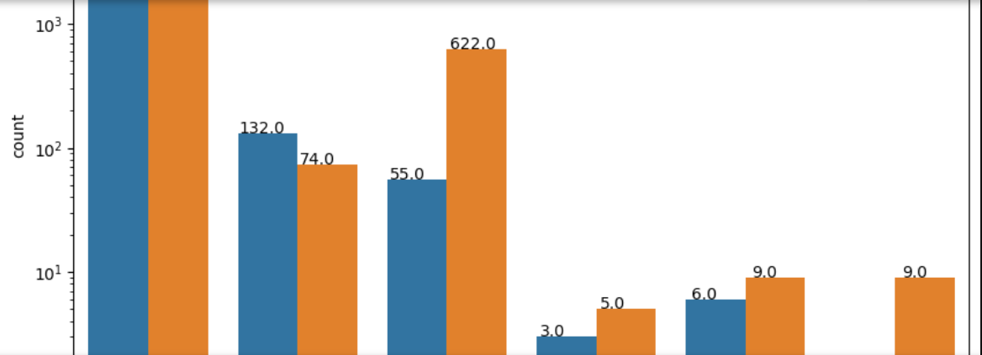
Exploratory Data Analysis

Slide 14
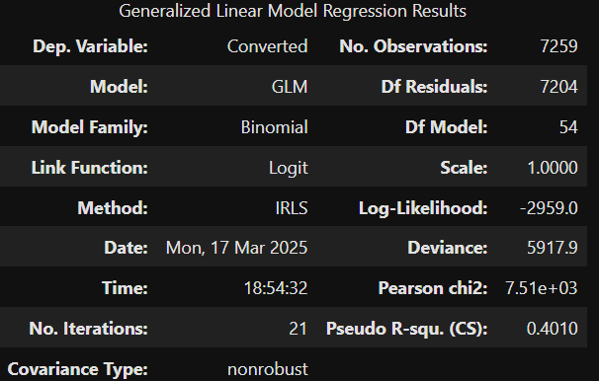
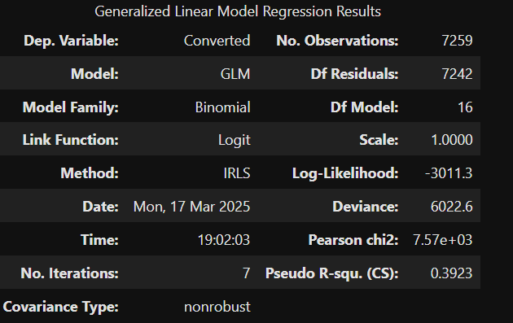
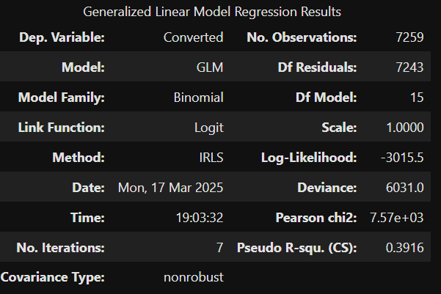
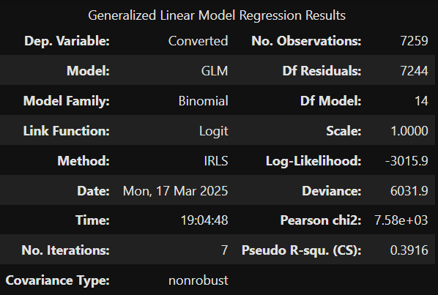
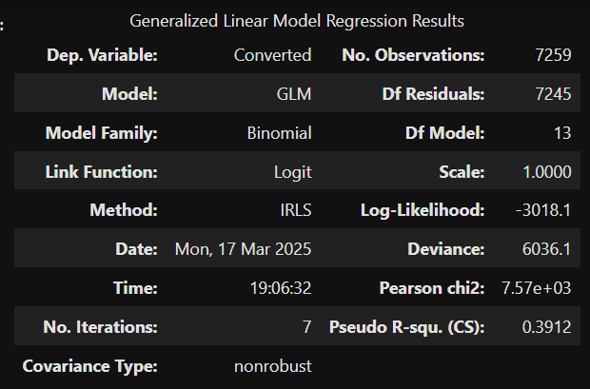
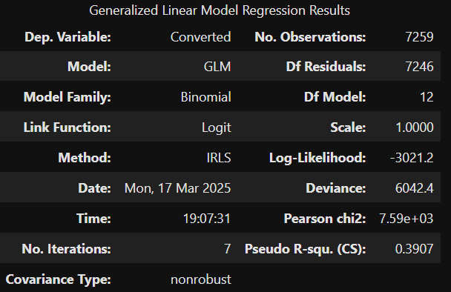
Models

Slide 15
Conclusion

